Slide 1
Implementing Soft-Unicast to Solve IPv4/IPv6 Limitations for Egress Traffic in CDN Infrastructure
Saber Mesgari
CPO @ ArvanCloud saber.mesgari@gmail.com

Slide 2
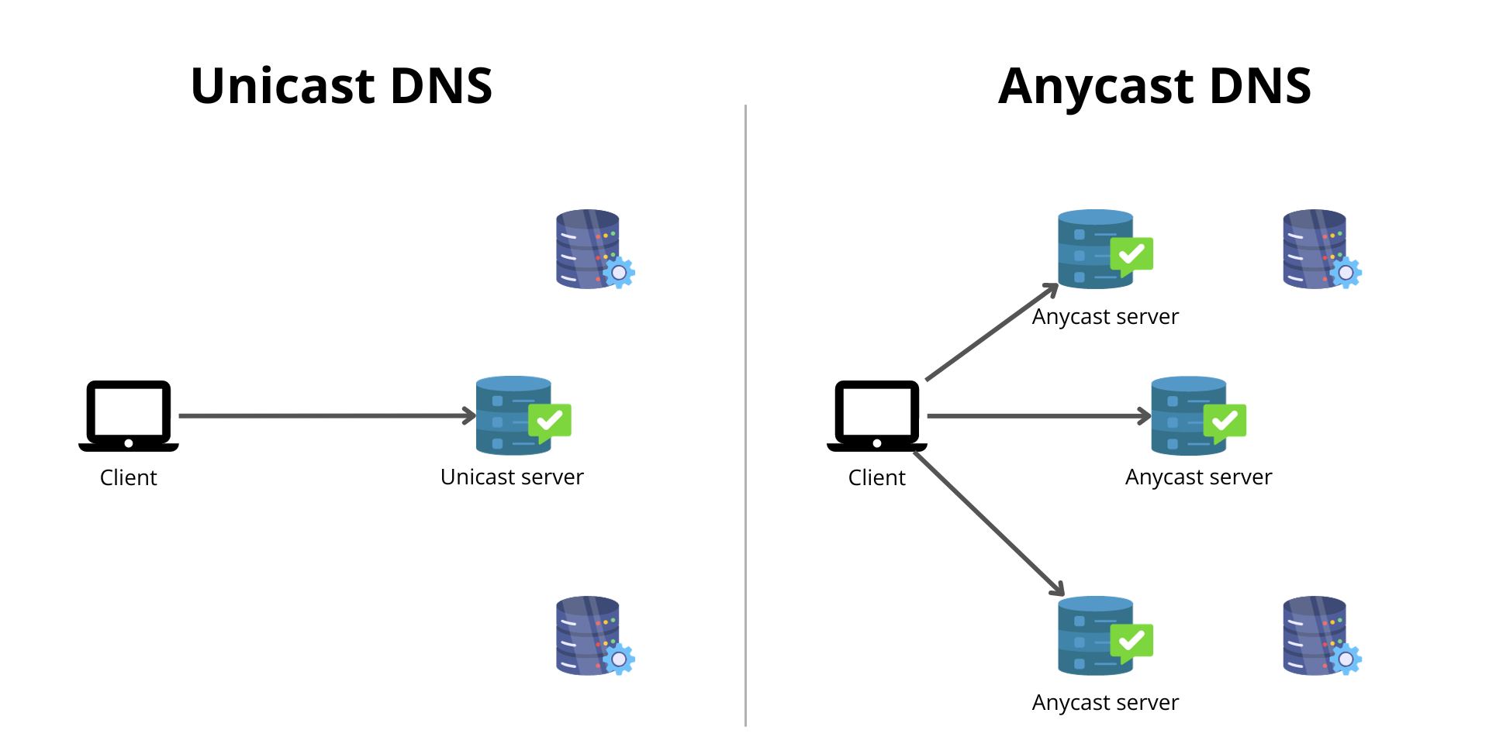
What is Anycast?
Anycast is a routing method where multiple servers share the same IP address.
Incoming traffic is routed to the nearest server (based on network topology, not physical distance), ensuring faster content delivery.

Slide 3
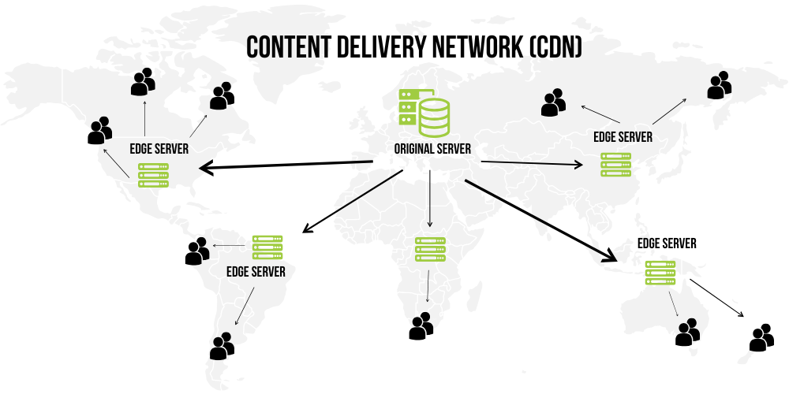
How/Why CDN use Anycast?
To Load Balance ingress traffic from end users to edge servers
Ingress traffic (user requests) is directed to the nearest CDN server, reducing latency and improving speed.
Distribute DDoS attack between multiple datacenters. With Anycast, attackers cannot target a specific datacenter or server

Slide 4
Benefits of Anycast for Ingress Traffic:
Reduced Latency
Load Balancing
Improved Reliability
Security
Efficient Routing
Scalable Traffic Management
Redundancy
Notes:
Reduced Latency: Users are connected to the nearest server, speeding up content retrieval.
Load Balancing: Traffic is automatically distributed among multiple servers based on proximity.
Improved Reliability: If one server fails, traffic is rerouted to the next available server without disruption.
Security: Prevent attacker for targeting a specific server or location
Efficient Routing: Traffic route to the nearest server based on network topology, not physical distance.
Scalable Traffic Management: Distributes traffic evenly across servers worldwide, improving scalability without overloading specific locations.
Redundancy: Traffic is routed to available servers even during network outages or server failures, improving overall reliability.

Slide 5
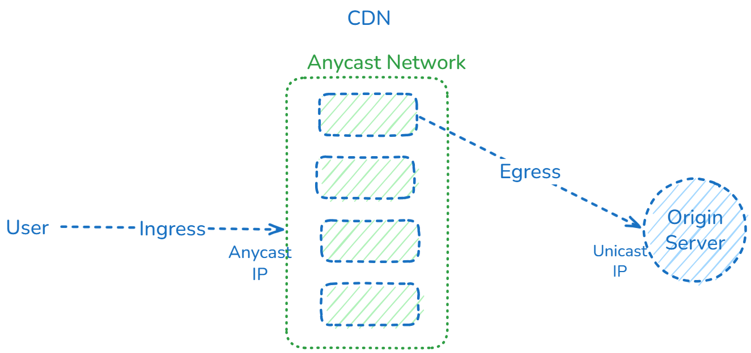
Anycast on ingress, unicast on egress
For connecting to upstream, CDN send traffic to upstream from unicast IP range

Slide 6
Limitations of Egress Traffic and the Problems with It
Egress Traffic Requires Unicast IPs
IPv4 Address Exhaustion
Cost of IP Address Management
Geotagging and Localized IP Needs
For a CDN Provider, it is hard to Add a new PoP Site
Even using IPv6, attacker can still target a specific resource(Server/Datacenter)
The CDN still need to re-route the traffic from one Data Center to Another one
Limitation for Dynamic Routing
Notes:
Egress traffic refers to the outbound data sent from servers to clients. Unlike ingress traffic, which benefits from anycast routing to the nearest server, egress traffic presents several unique challenges for CDNs, as highlighted in the article. These challenges include:
Egress Traffic Requires Unicast IPs:
Anycast is not suitable for egress traffic because it can’t guarantee that return packets reach the right server.
Unlike ingress traffic, which is routed to the nearest server via anycast, egress traffic (such as server-initiated connections) requires unicast IPs to ensure that the data reaches the correct server.
The problem is that unicast IPs need to be unique and manually allocated to each server, causing a need for additional IP addresses, especially as server count grows.
IPv4 Address Exhaustion:
The growing need for unique egress IPs exacerbates the ongoing IPv4 exhaustion issue.
For each server initiating outbound connections, a separate IPv4 address is typically required. However, the pool of available IPv4 addresses is limited, and this scarcity increases the cost of maintaining a large number of servers that each require their own egress IP.
Cost of IP Address Management:
As the demand for multiple unicast IP addresses per server rises, the costs associated with managing and acquiring these addresses also increase.
For CDNs with thousands of edge servers, the need to allocate and manage numerous egress IPs results in significant operational costs.
Geotagging and Localized IP Needs:
Certain services and applications depend on geotagging based on IP addresses (such as regional compliance or location-based content delivery).
To meet these demands, multiple egress IPs are needed for different geographical locations. This requirement introduces further complexity and overhead in managing IP assignments.
IPv4 Scarcity: The need for many egress IPs increases pressure on the limited IPv4 space, driving up costs and complicating IP management.
Geotargeting Needs: IP addresses need to be assigned by region to ensure compliance with geolocation-based services, adding to the complexity of egress traffic management.
Increased Costs: Acquiring and managing large numbers of unique IPs for egress traffic increases costs for service providers, especially as demand grows.

Slide 7
Solution: Soft-Anycast for Egress Traffic
Introduced by Cloudflare
Soft-Anycast is the innovative solution that bridges the gap between the scalability benefits of anycast for ingress traffic and the uniqueness required for egress traffic.
Key Concept: Egress IPs are still advertised using Anycast, but each server is assigned a unique port range, allowing multiple servers to share the same IP address.

Slide 8
How Soft-Anycast Solves the Egress Challenges
IP Address Sharing Across Servers:
Multiple servers can share the same egress IP, with port slicing ensuring that each server can independently route traffic.
Each server is assigned a range of ports, making it possible to share the same IPv4 address without IP conflicts.
Dynamic Load Balancing:
A custom load balancer routes traffic based on the IP:PORT combination, ensuring that packets are directed to the correct server.
The load balancer dynamically distributes traffic, preventing overuse of any single server or port range

Slide 9
How Soft-Anycast Solves the Egress Challenges
IPv4 Savings:
By reusing a single IP across multiple servers, Soft-Anycast reduces the need for unique egress IPs, leading to significant IPv4 savings.
Soft-Anycast allows CDNs to continue operating efficiently while alleviating the burden of acquiring and managing a vast number of IPv4 addresses.

Slide 10
Why using IPv6 cannot fix all problems?
With IPv6, still CDN providers need Dynamic Routing
Without Anycast in connection with origin servers, attacker can send DDoS attacks to a specific Data Center

Slide 11
Benefits of Soft-Anycast for Egress Traffic
Reduced Costs:
Significantly lowers the operational cost of maintaining many egress IPs.
Geotargeting Support:
Continues to support regional IP needs for services like geofencing and compliance.
Improved Reliability:
Traffic is rerouted to the next available server if one fails, ensuring high availability without relying on multiple unicast IPs.

Slide 12
Methods for implementing Soft-Unicast
IP Slicing for select the target datacenter
Assign different IP to different datacenter
Reroute received traffic from origin server to target datacenter

Slide 13
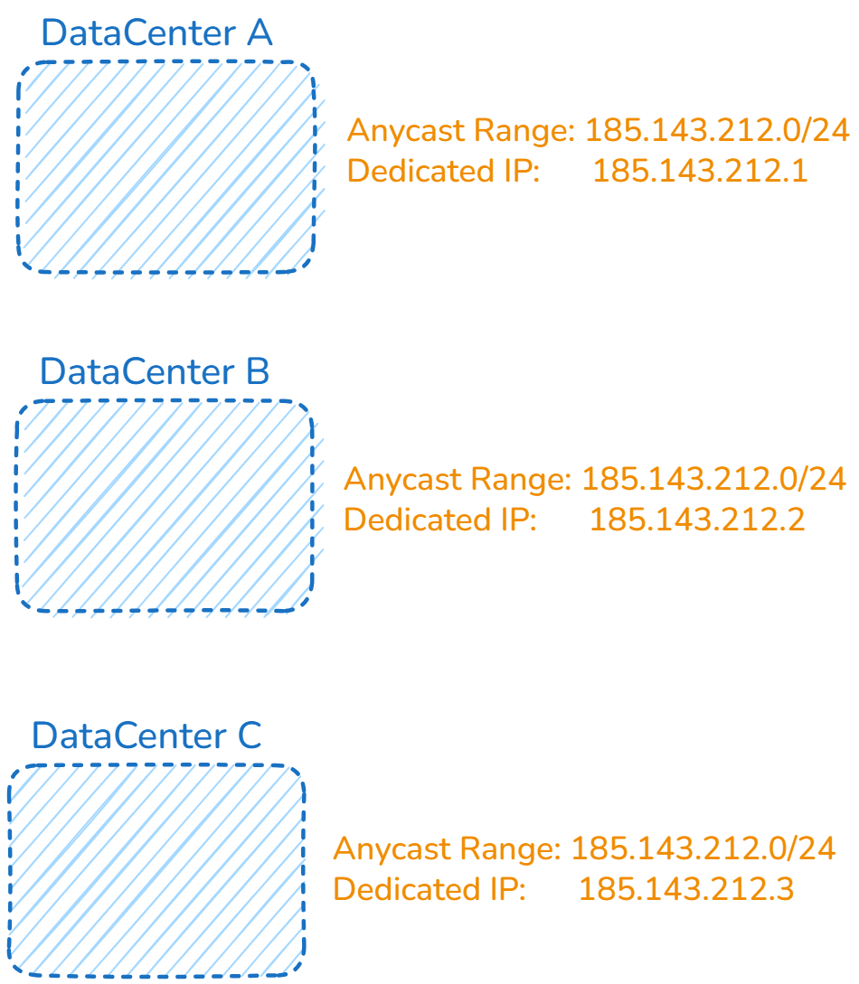
IP Slicing
Advertise Same Range(/24) from all DC
Set a single /32 to each DC

Slide 14
Methods for implementing Soft-Unicast
Port Slicing
Assigning different port range to each group of servers
Re-Route Replied traffic to corresponding servers with
Each server is allocated a unique port range.
Port ranges allow multiple servers to share the same IP, with traffic routed based on port.

Slide 15
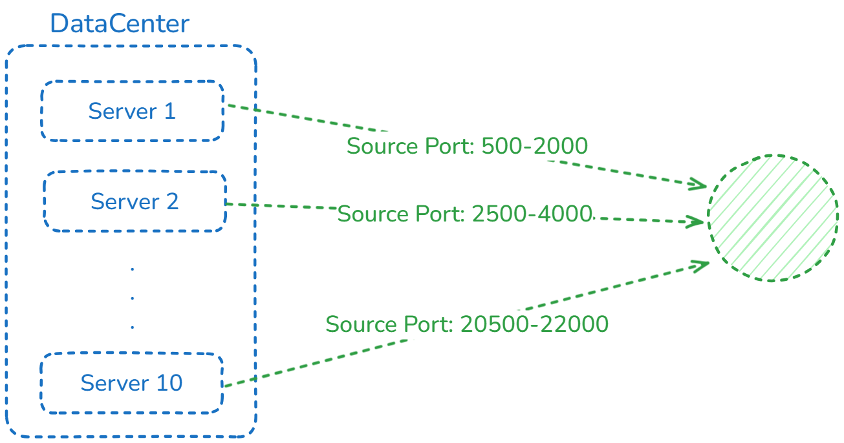
Port Slicing for Servers inside of Datacenter

Slide 16
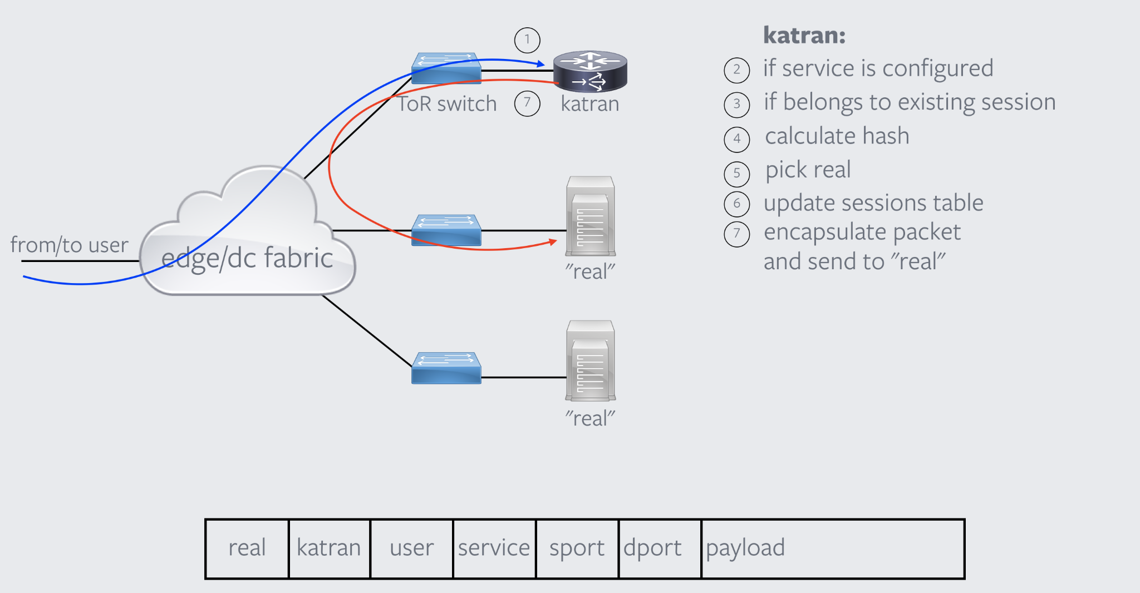
Katran as a DSR Load Balancer
We can use any DSR Load Balancer to implement Soft-Unicast
Katran Introduced by Meta
Work as a DSR(Direct Server Response) L4 Load Balancer
High Performance and Scalable LB Solution
Works on a L3 Network

Slide 17
Dynamic Port Management
As the infrastructure grows, Our Load Balancer must dynamically assign port ranges to new servers.
This ensures scalability while maintaining efficient port usage.
Port ranges must be managed dynamically across all backend servers.

Slide 18
Steps for Implementing Soft-Unicast using Katran
Set Up Katran on Your Network Infrastructure
Install Katran on a Linux system, ensuring it’s compatible with your network setup (e.g., a data center environment or containerized infrastructure like Kubernetes).
Ensure you have a kernel version that supports eBPF and XDP for optimal packet processing.

Slide 19
Modification Needed for Port-Based Forwarding
Katran Source Code should change to support Port Slicing for BackEnd Servers
The eBPF code needs to be adjusted to support routing based on both the IP address and port range. This ensures that outgoing traffic is forwarded to the correct server

Slide 20
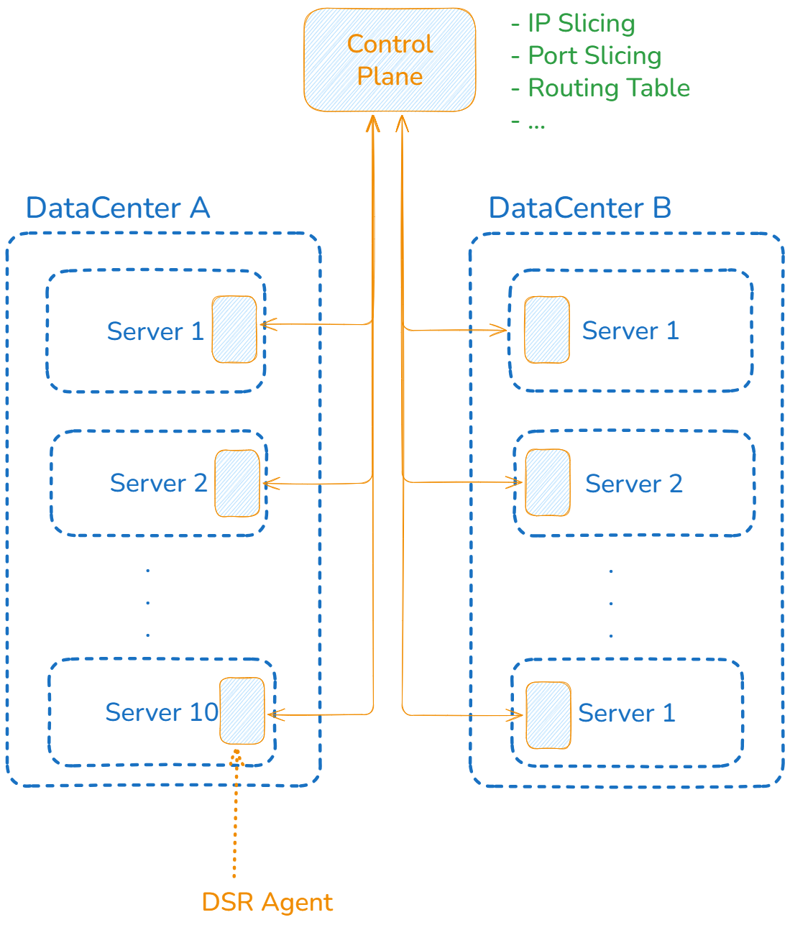
Modification Needed for Port-Based Forwarding
Also we need a Centralized Control Plane to support dynamic routing, IP and Port Slicing

Slide 21
Maintain Low Latency
Katran is designed for low-latency packet processing.
It’s essential to ensure that the added complexity of port slicing doesn’t negatively impact performance.
Optimize eBPF processing to ensure minimal overhead and maximum efficiency.

Slide 22
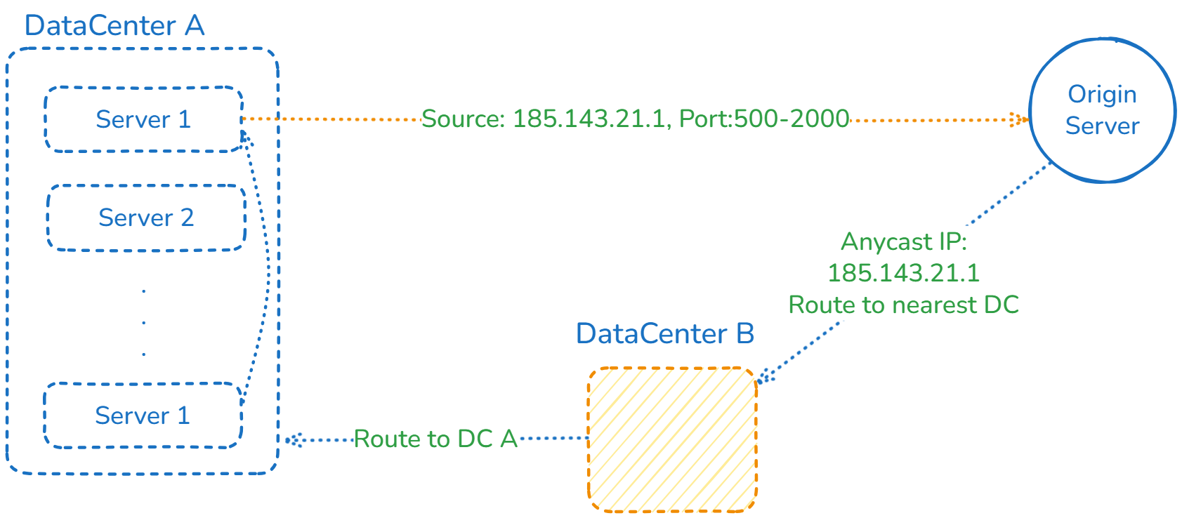
Reroute Traffic

Slide 23
Benefits of Soft-Unicast with Katran
IPv4 Efficiency: Reduces the need for multiple unicast IPs, addressing IPv4 exhaustion.
Scalability: Supports large-scale deployments by efficiently managing IP addresses and port ranges.
High Performance: Maintains low latency and high throughput while enabling port slicing.
Cost-effective: Minimizes operational costs related to IP address allocation and management.

Slide 24
Steps for Implementing Soft-Unicast using Katran:
Soft-Unicast requires a shared IP address for multiple backend servers with each server assigned a unique port range. This ensures that the egress traffic can still be routed efficiently while maintaining the use of a single IP.
Modify Katran’s configuration to support port slicing for the egress IP. Each server in the network will advertise the same IP address but will be differentiated by a unique set of ports.
Example:
Server 1: IP 192.168.1.1:1000-2000
Server 2: IP 192.168.1.1:2001-3000
Port Slicing: Katran’s load balancer needs to route traffic based on the combination of the IP address and port, ensuring that egress traffic reaches the correct server.

Slide 25
Benefits of Soft-Unicast
Solve Limited resource of IPv4
By using the same IP range for multiple datacenters
Mitigate the risk of DDoS Attack, Pointed to a specific server/datacenter
By dynamic routing, Attacker cannot target a single server/datacenter
Improve Performance
Traffic from origin server receive from nearest datacenter, because of BGP Anycast

Slide 26
Any Question?

